Slide 1
CS389 INNOVATION LAB
IoT - Network Intrusion Detection System
Mukund Sharma 2101AI19

Slide 2
PROBLEM STATEMENT
Network Intrusion Detection based on various machine learning & deep learning algorithms using UNSW-NB15 Dataset
Performing Binary and Multi-class Classification & testing scoring metrics

Slide 3
MOTIVATION
Interest in Machine Learning Domain
What Innovation will I contribute to ? (Target)
Better preprocessing of the dataset than already available methods. Performing best feature selection to favour model training. Trying large number of algorithms, tune their parameters & hyper parameters, and test their performance based on many statistical methods in order to find the best algorithm to perform classification of a new example.

Slide 4
PROGRESS TILL NOW
Preprocessing Techniques
Exploratory Data Analysis (EDA)
Feature Selection
Classification Algorithms
Hands on Experience of Libraries that will be used
Hyper parameter tuning techniques

Slide 5
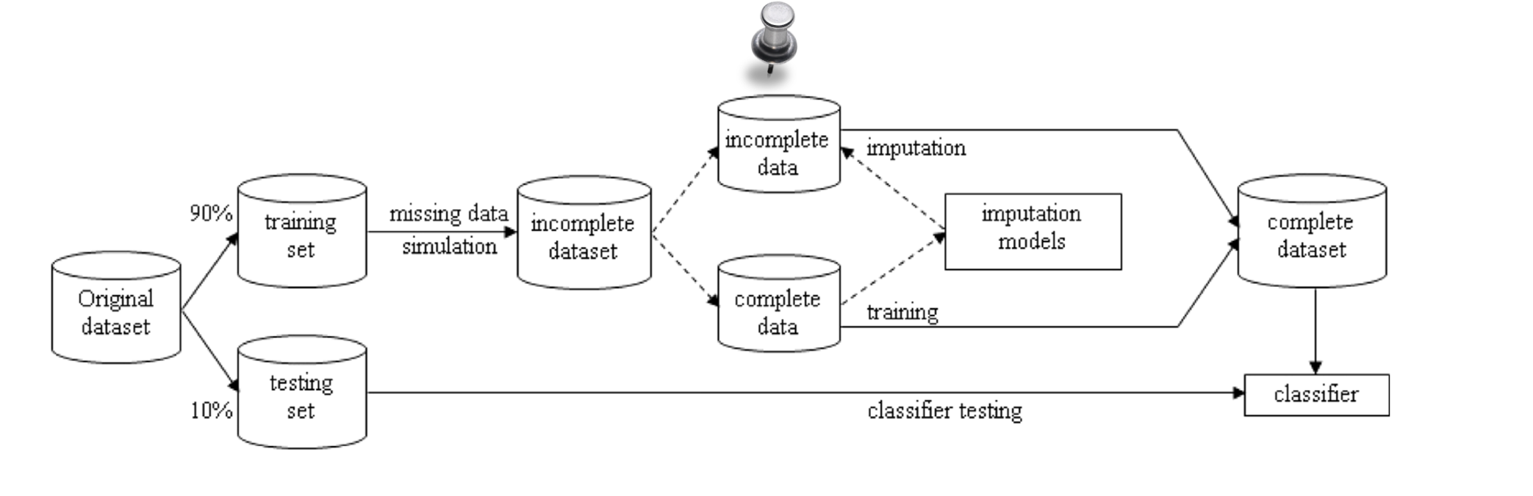
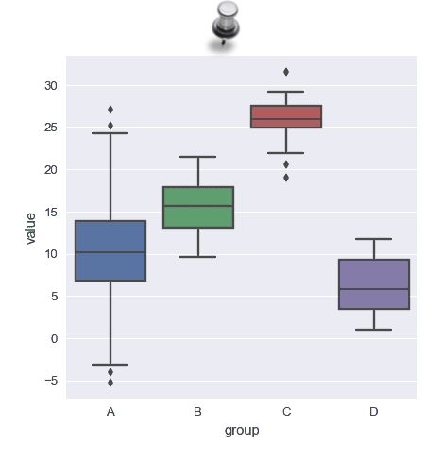
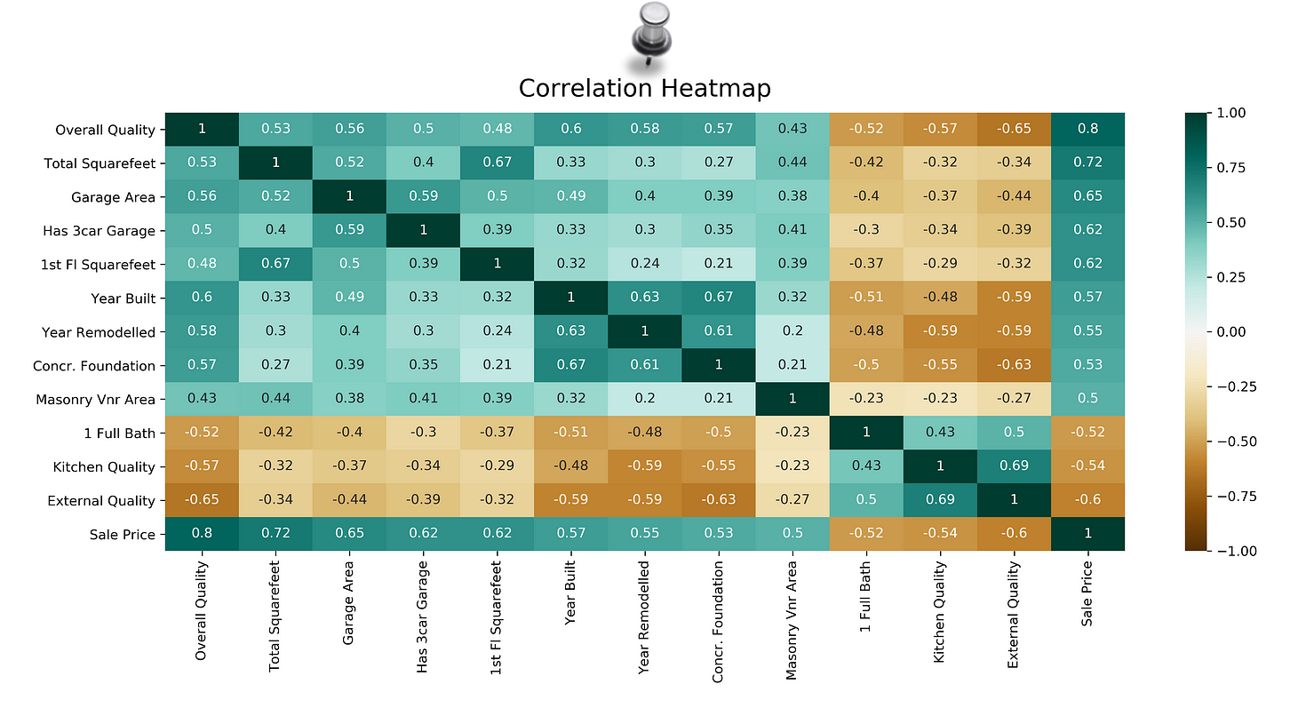
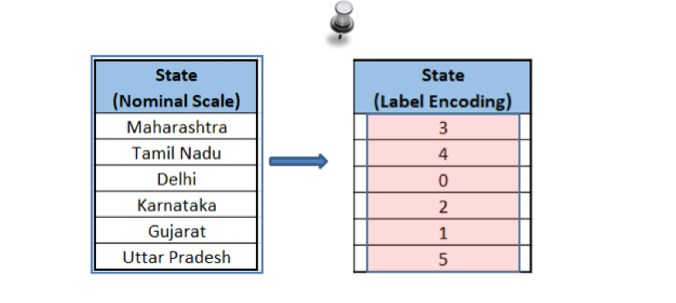

Slide 6
YET TO LEARN / TASKS REMAINING
Statistical Analysis Techniques
Getting Better Domain Knowledge
PyTorch
Pickle
Compiling the Whole Notebook

Slide 7
THANK YOU !

